Slide 1




Kalman-and-Bayesian-Filters-in-Python
The g-h Filter
Mar 12th, 2022 https://github.com/duyongquan/LTSLAM
AibotBeginer 视觉SLAM
quandy2020@126.com

Slide 2
2
Outline
Building Intuition via Thought Experiments
Exercise: Varying g
The g-h Filter
Varying h
Notation
Interactive Example
Exercise: Write Generic Algorithm
Don’t Lie to the Filter
Choice of g and h
Tracking a Train
Exercise: create measurement function
g-h Filters with FilterPy
Exercise: Bad Initial Conditions
Summary
Exercise: Extreme Noise
Exercise: The Effect of Acceleration

Slide 3
Building Intuition via
Thought Experiments
3
通过实验直觉建立思想

Slide 4

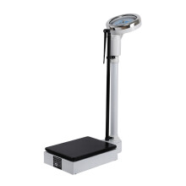
4
Building Intuition via Thought Experiments
体重秤
1
第一次体重： 161 lbs
Sensors are inaccurate
2
第二次体重： 172 lbs
Try Another Scale
How can improve upon this result ?
体重秤
A
first scale (A) reads “160 lbs”
B
second (B) reads “170 lbs”

Slide 5
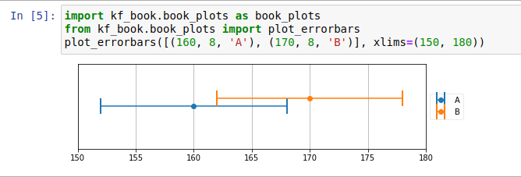
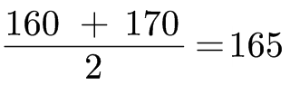
5
Building Intuition via Thought Experiments
What are our choices?
a
We could choose to only believe A, and assign 160lbs to our weight estimate
b
We could choose to only believe B, and assign 170lbs to our weight.
c
We could choose a number less than both A and B.
d
We could choose a number greater than both A and B.
e
We could choose a number between A and B.
Best estimate is the average of A and B

Slide 6
The g-h Filter
6
g-h滤波

Slide 7
7
The g-h Filter
What g-h Filter ?
α-β filter
g is the scaling we used for the measurement
h is the scaling for the change in measurement over time
Ohter books quite difficult to learn
notation is introduced without explanation
books are almost devoid of examples or worked problems
no idea as to what real world phenomena these words and math were attempting to describe

Slide 8
Notation
9
符号表示

Slide 9
10
Notation
Measurement
Measurement is typically denoted z
Subscript k indicates the time step
A bold font denotes a vector or matrix
x denotes state
For our scale example, it represents both the initial weight and initial weight gain rate, like so:

Slide 10
Exercise: Write Generic
Algorithm
9
练习：一般性算法

Slide 11
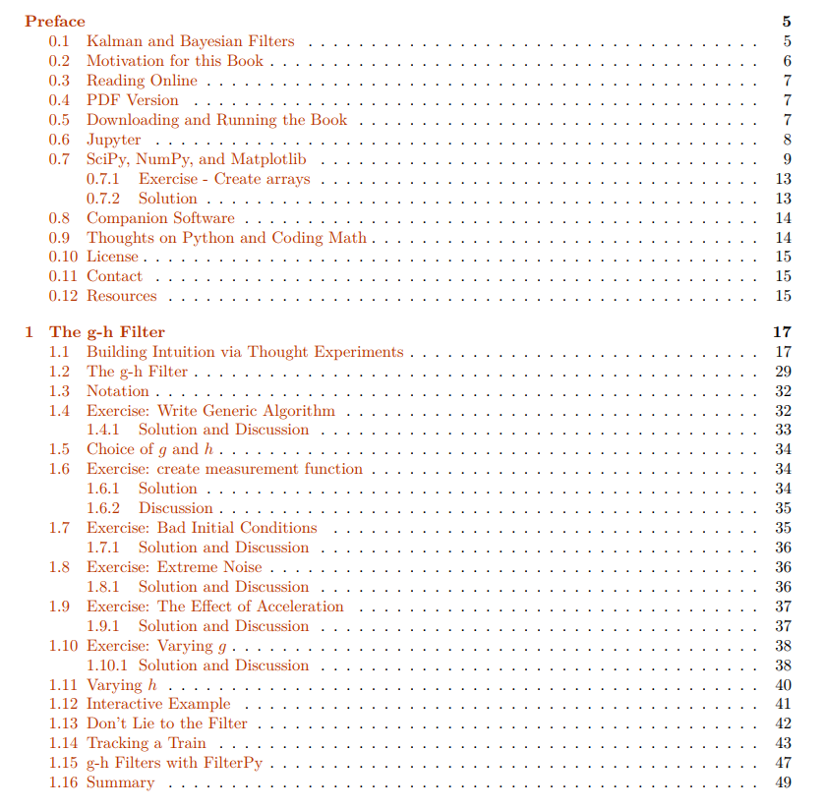
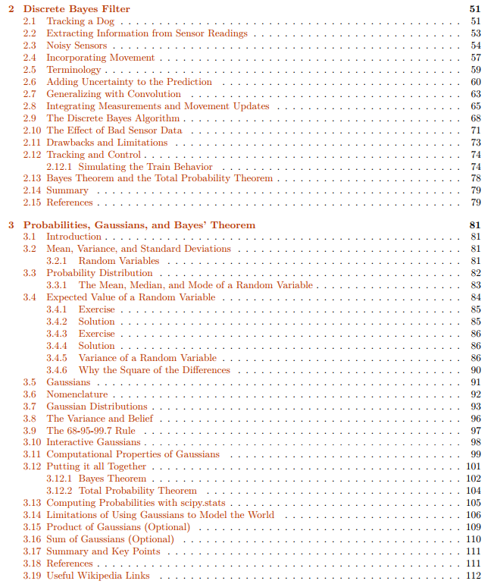
10
PDF Version
PDF book
https://drive.google.com/file/d/0By_SW19c1BfhSVFzNHc0SjduNzg/view?resourcekey=0-41olC9ht9xE3wQe2zHZ45A

Slide 12
Downloading and Running
the Book
11
下载和运行

Slide 13
12
Downloading and Running the Book
Installation
http://nbviewer.ipython.org/github/rlabbe/Kalman-and-Bayesian-Filters-in-Python/blob/master/Appendix-A-Installation.ipynb
Introduce
This book is intended to be interactive and I recommend using it.
Its a little more effort to set up.
You can perform experiments, see how filters react to different data, see how different filters react to the same data, and so on

Slide 14
Jupyter
13
开发环境

Slide 15
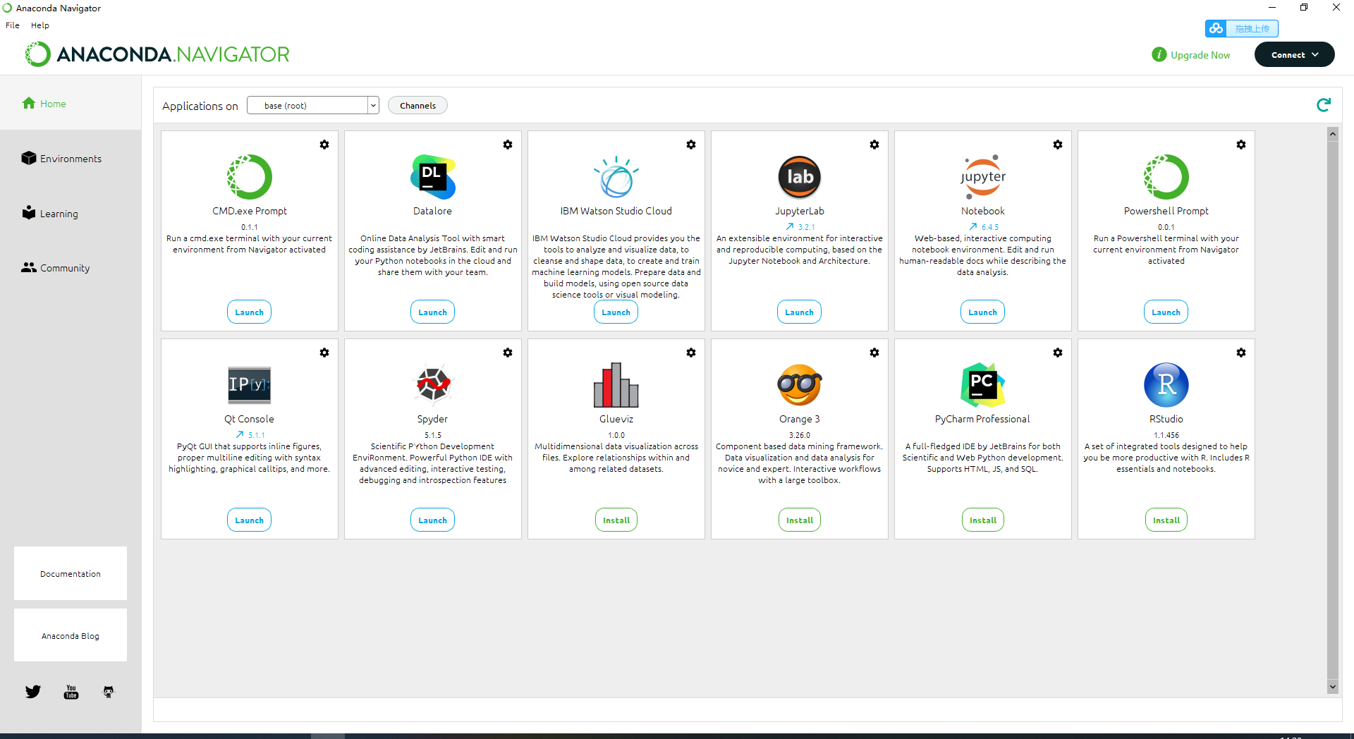
14
Jupyter
jupyter notebook
安装Anaconda

Slide 16
SciPy, NumPy, and Matplotlib
15
Python 库

Slide 17
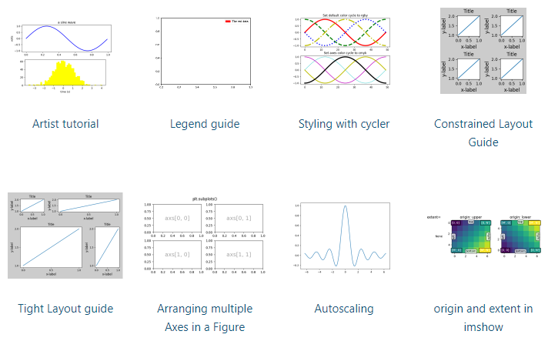
16
SciPy, NumPy, and Matplotlib
SciPy is a mathematic
array objects
https://scipy.org/
linear algebra
random numbers
NumPy
Matplotlib
https://matplotlib.org/stable/tutorials/index

Slide 18
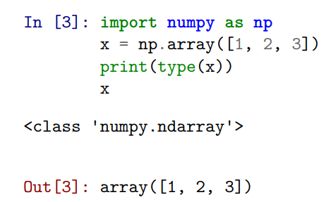
17
SciPy, NumPy, and Matplotlib
numpy.array implements a one or more dimensional array

Slide 19
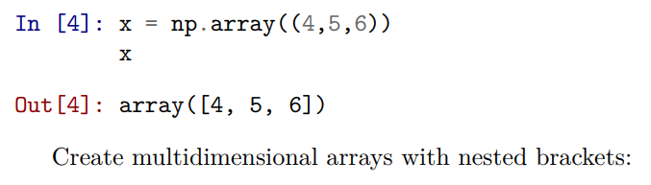
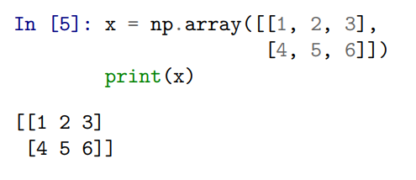
18
SciPy, NumPy, and Matplotlib
numpy.array implements a one or more dimensional array

Slide 20
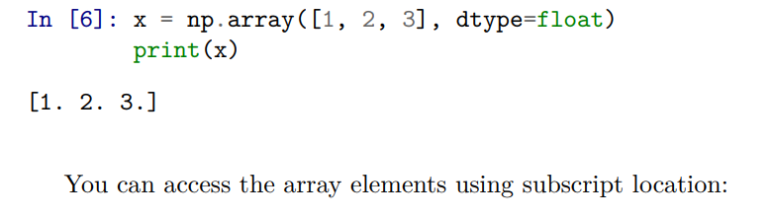
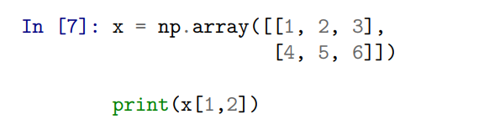
19
SciPy, NumPy, and Matplotlib
numpy.array implements a one or more dimensional array

Slide 21
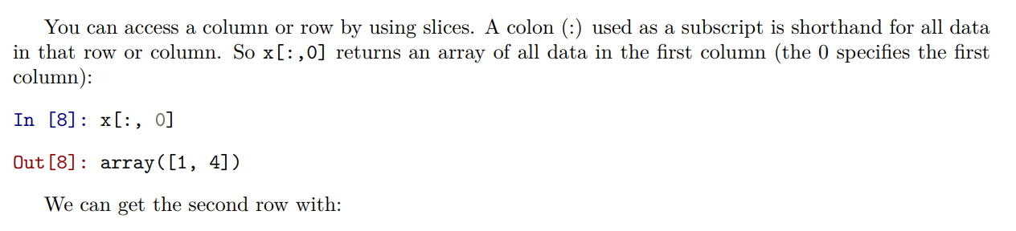
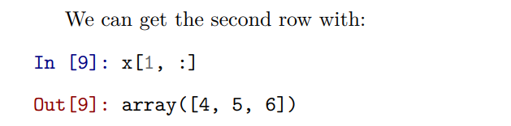
20
SciPy, NumPy, and Matplotlib
numpy.array implements a one or more dimensional array

Slide 22
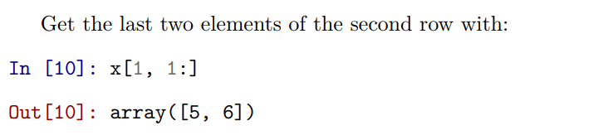
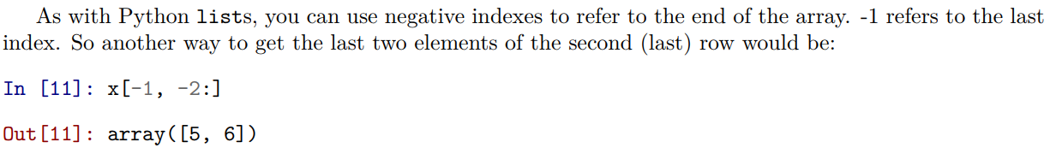
21
SciPy, NumPy, and Matplotlib

Slide 23
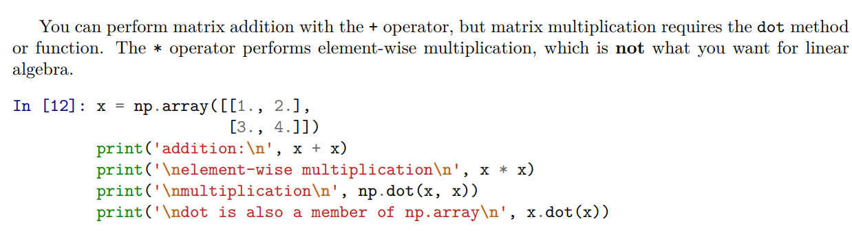
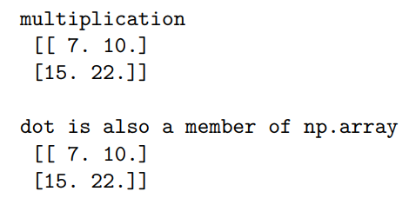
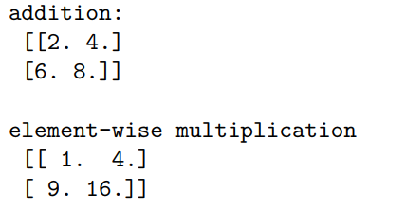
22
SciPy, NumPy, and Matplotlib

Slide 24
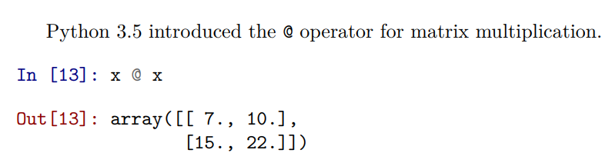
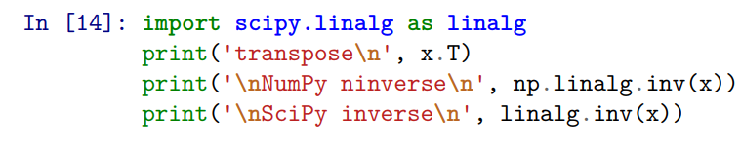
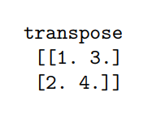
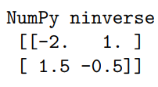
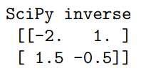
23
SciPy, NumPy, and Matplotlib
transpose and the inverse

Slide 25
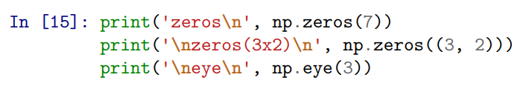
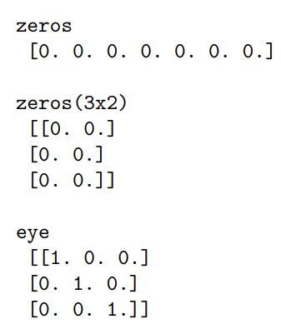
24
SciPy, NumPy, and Matplotlib
zeros matrix , ones matrix, eye identity matrix

Slide 26
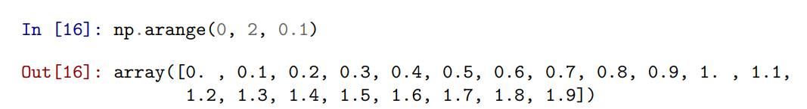
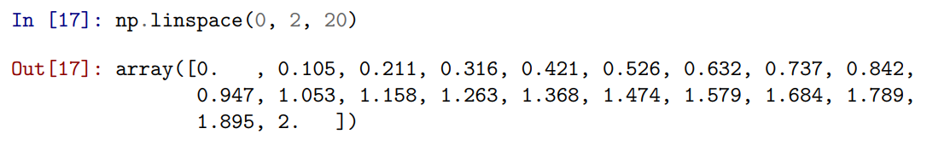
25
SciPy, NumPy, and Matplotlib

Slide 27
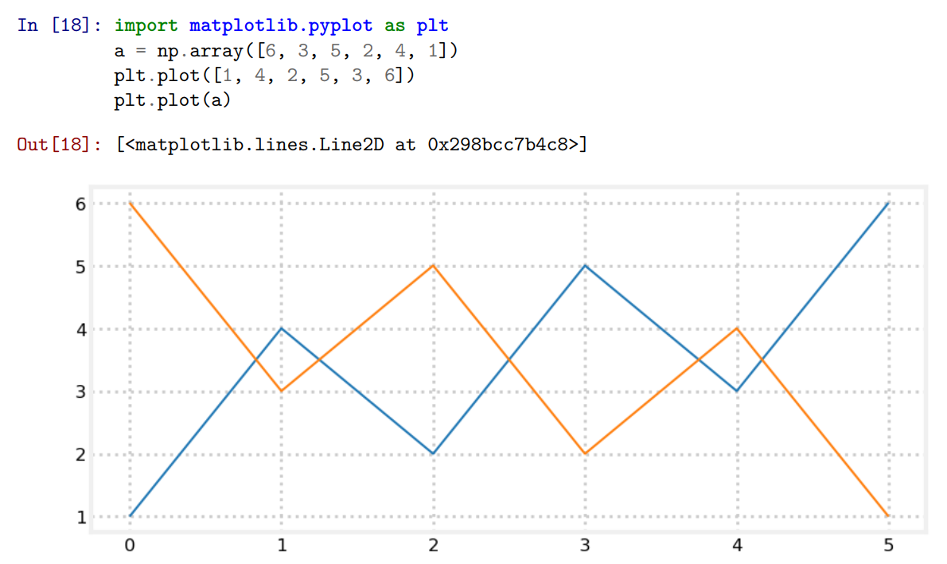
26
SciPy, NumPy, and Matplotlib

Slide 28


